Slide 1
Photos, Film, and Visual Literacy
EDC&I 583
Message Design
15 February 2012

Slide 2
Plan of Action 2/15/12
Good and bad examples
Redesign presentations I
Discuss readings
Presentation: Photos, Film, and Visual Literacy
Redesign presentations II
Discuss Reviews of Literature

Slide 3
Photos
When is a photo “realistic”
Does “realism” matter?
How do photos tell a story?

Slide 4
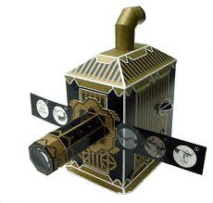
The Great Realism Debate
From 1930s, in US education
Assumption: The more realistic the medium, the more students would learn
Coincided with the appearance of (relatively) cheap devices for showing, using, reproducing photos in ed settings ( incl. textbooks themselves)

Slide 5
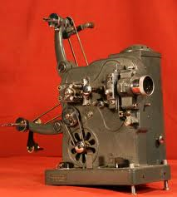
What Was Realistic?
Projected better than printed (brighter)
Moving better than still (closer to nature)
With sound better than without (ditto)
But…

Slide 6
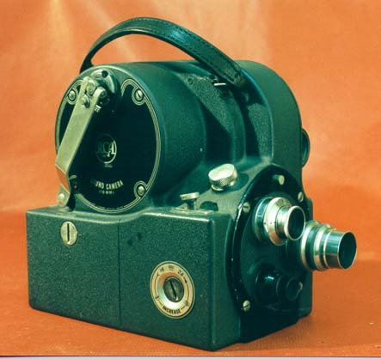
NSD
No actual evidence to support this claim
Various empirical studies in 1940s-1960s found no significant differences
In fact, some evidence to the contrary
(Huh?)
World's first 16mm optical sound-on-film camera (RCA Victor; 1935)*
*[Now = 2% of your cell phone]

Slide 7
Realism for What?
“Realism” turns out to be a relative notion
For a novice, realistic detail = overwhelming
Graphic outlines, diagrams may help generate a “mental model” of a concept/structure
Add detail as the structure becomes more familiar
Even near-experts may require labels and other guides to help decipher structures

Slide 8
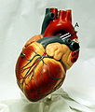
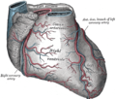
Frank Dwyer and the Pig’s Heart
What makes learning easiest, for whom, under what conditions?
Researcher at Penn State, 1962-2007
Over 150 studies on visual representation, realism
Many involved learning structure of the heart
Human cadavers were scarce, so they used pigs’ hearts
Is realism good? Depends…

Slide 9
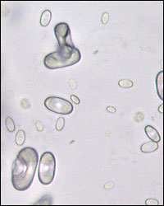
And Context Matters
How and where knowledge is to be used makes a major difference
Identification, classification (triage), diagnosis (relation to surrounding systems), action (surgery), etc. = different kinds of mental activity
Tufte’s “smallest effective difference” is often important in designing photo displays
“What do you have to be able to distinguish?”
UW Medicine’s Urinalysis Tutor

Slide 10
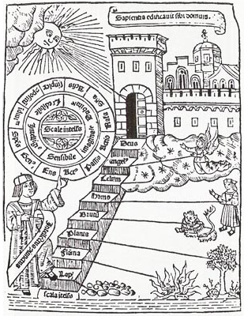
So How Do We Learn…
How to interpret this stuff?
“Visual literacy”: a distinct domain?
From 1960s; John Debes at Kodak (!?) – IVLA
Hard to draw exact parallels
“Grammar,” “syntax,” etc. not equivalent
But probably related…

Slide 11
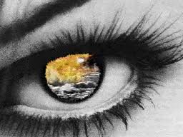
But, Increased Interest Today
Cf. “Digital Natives” discussion (Marc Prensky)
Rise of easy digital production and distribution
Cell phone cameras, YouTube, etc.
Decreasing focus on print literacy
Demand for “smaller chunks” of print material
Rise of “New Literacies” work

Slide 12
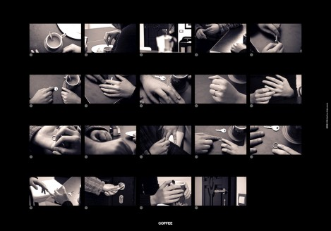
Visual/Digital Storytelling
Increasing awareness that today’s public likes visual imagery
Little agreement on what factors are most critical
Increasing number of programs nationally to help people prepare digital stories (including here at UW and UW-B…)

Slide 13
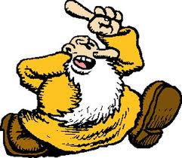
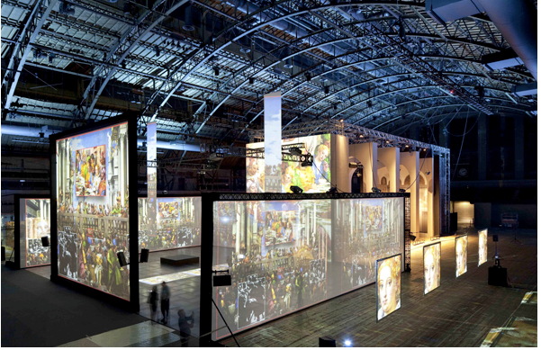
Merging Art and Communication
Experimentation between/among media and the arts
A “digital visual turn” in what’s seen as legitimate
Cf. Seattle’s Frye Art Museum
From late 19th c. German realism to R. Crumb in 100 years
What would visitors to New York’s 1913 Armory Show make of what we have now?

Slide 14
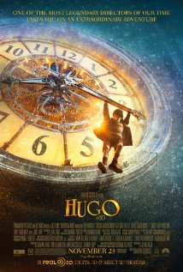
Moving Right along…
…to some aspects of moving imagery
The visual aesthetic of film and video
This stuff didn’t just appear overnight
Editing
Special effects
Montage, juxtaposition, zoom
Cf. George Melies & Hugo

Slide 15
Manipulating How We See the World
Three key effects:
Time Lapse
Slow Motion
Zooming

Slide 16
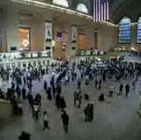
Time Lapse
Speeding time up
(Show what happens over long time in a much shorter period)
Fun!
But also has significant implications for learning

Slide 17
The Gecko Question
How long does it take ants to consume a dead gecko?
What a great question!
What other questions could this stimulate?

Slide 18
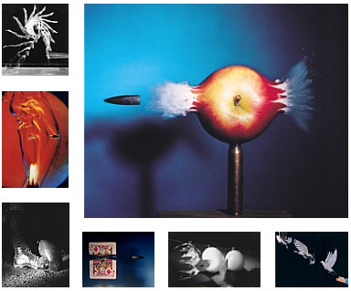
Sl o w M o t i o n
Slowing time down
(Show what happens over a very short time in a much longer period)
Pioneer: Harold “Doc” Edgerton at MIT
Not the inventor, but assembled the pieces

Slide 19
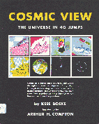
The Zoom
Powers of 10 by Charles & Ray Eames
One of many versions (both Eameses and others)
Original concept: Kees Boeke, Cosmic View

Slide 20
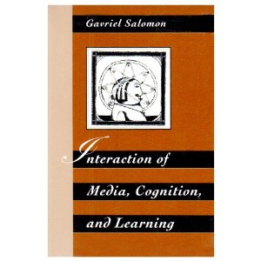
And Some Provocative Research
Gavriel Salomon’s “zooming” studies, 1970s
An effort to “take McLuhan seriously”
Conditions: zooming and re-framing
“Zoomers” noted more details in subsequent tests

Slide 21
But: Manipulation Deceives
“End of photography/video as evidence of anything”
Even young kids are aware that images can be changed and “aren’t to be trusted”

Slide 22
Summing Up
Photography changed in important ways how we look at the world, and how we imagine acting in it
Visual effects created in photography and film have entered widespread common use
But images now seen as less “trustworthy” than they were

Slide 23
Questions for Discussion
[Woolner et al.] Your experience with picture/map based planning and decision making – Does it help or hinder, and how?
[Timmers & van der Wijst] Your experience with images and “fear appeals” – How effective? Lead to actual behavior change?
[Williams] The Four Principles:
Proximity
Alignment
Repetition
Contrast
Do you find yourself more aware of these? Finding examples of their use (or ignorance of them) in the surrounding world?

